Slide 1


Slide 2
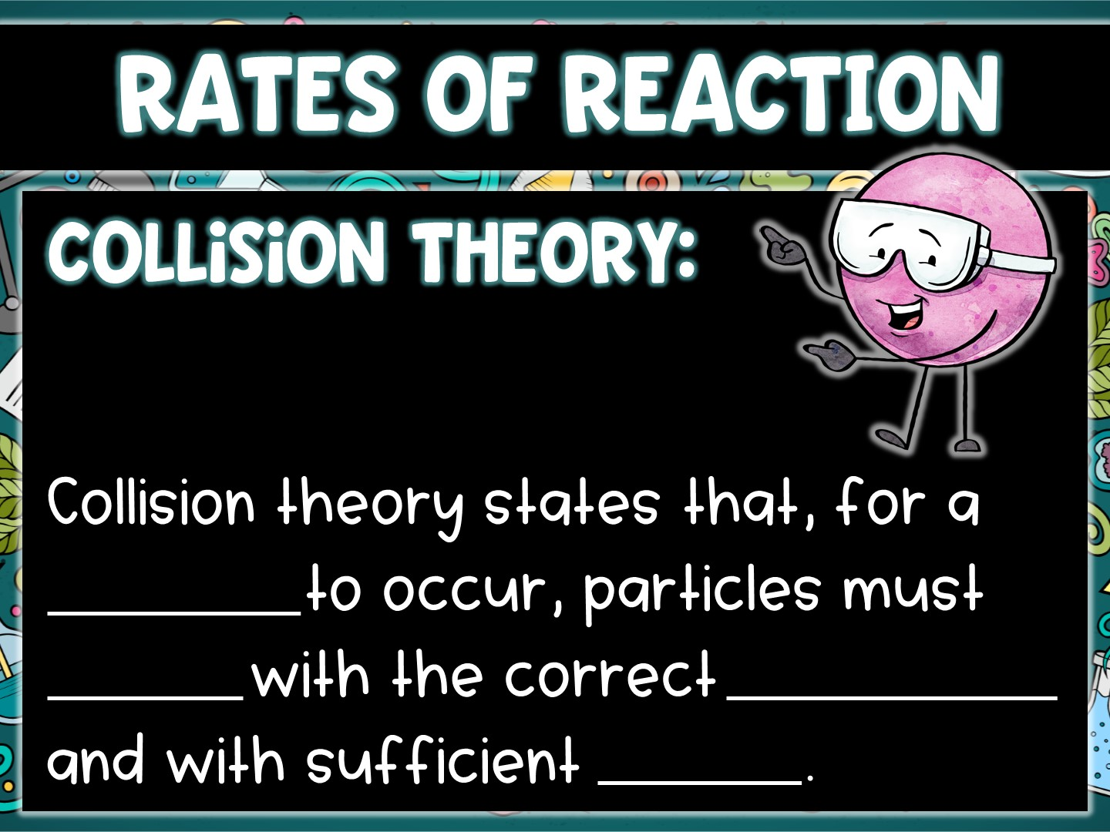
reaction
collide
orientation
energy

Slide 3
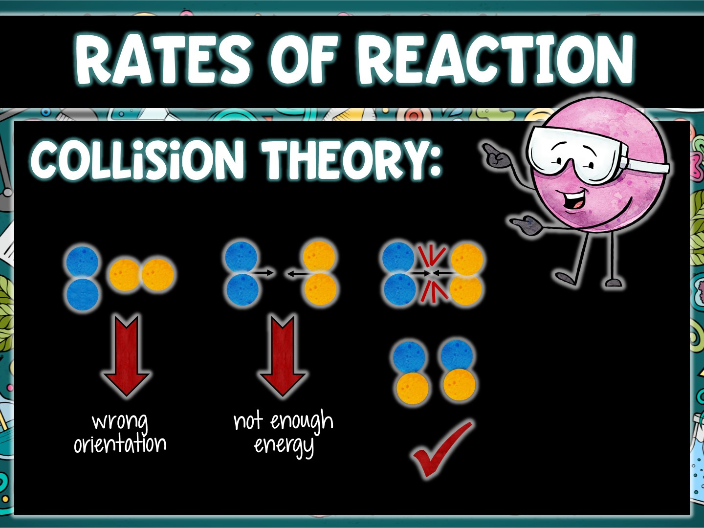

Slide 4
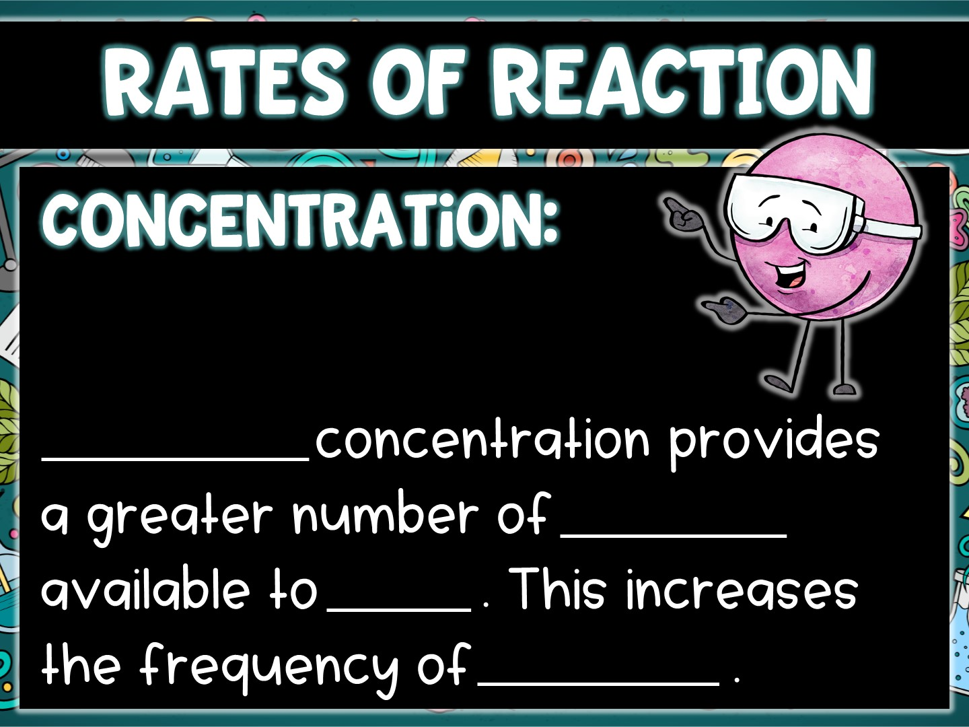
Increasing
particles
react
collisions

Slide 5
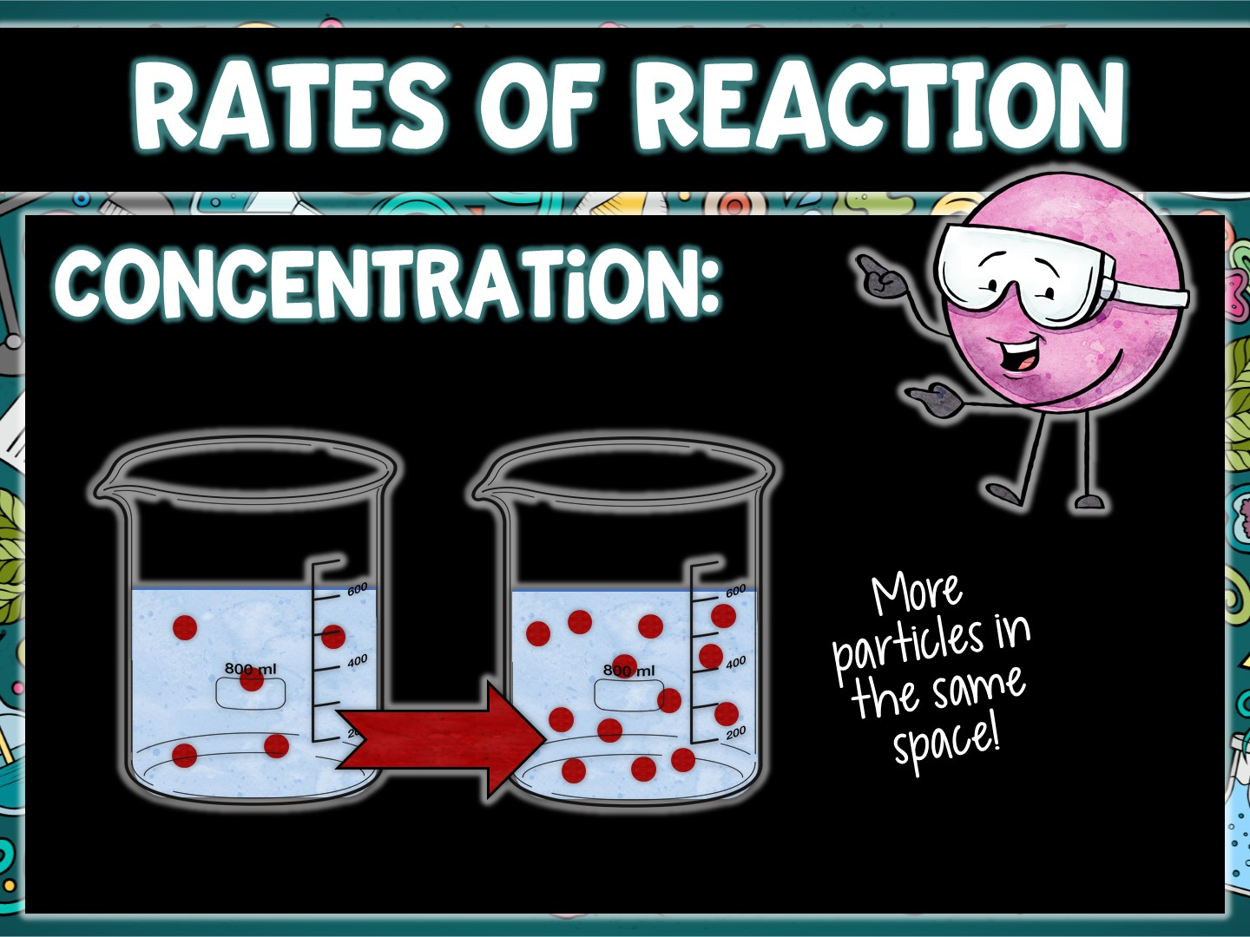

Slide 6
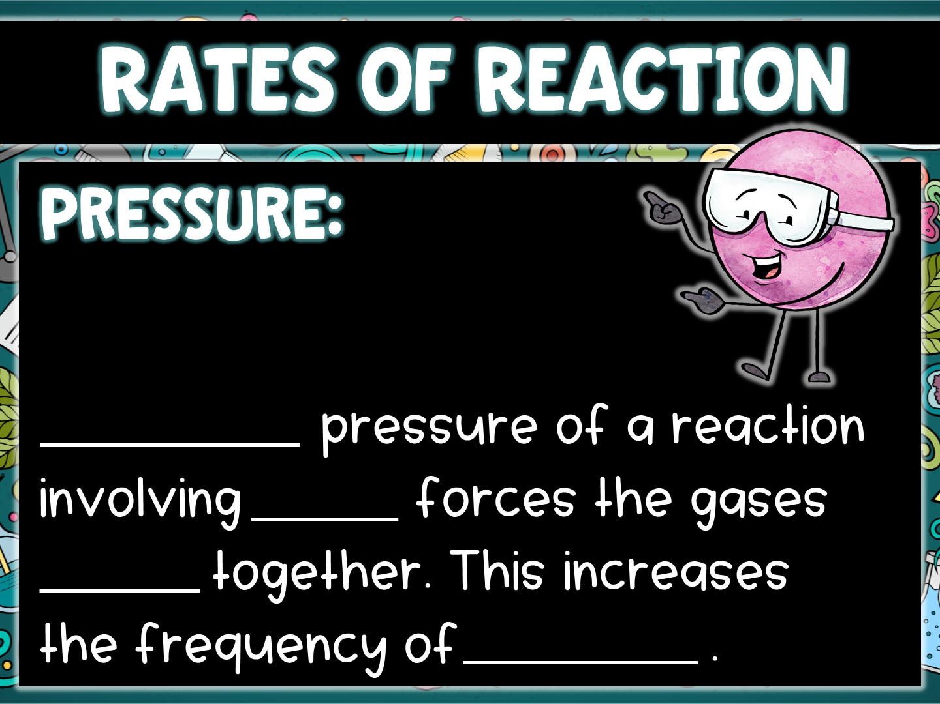
Increasing
gases
closer
collisions

Slide 7
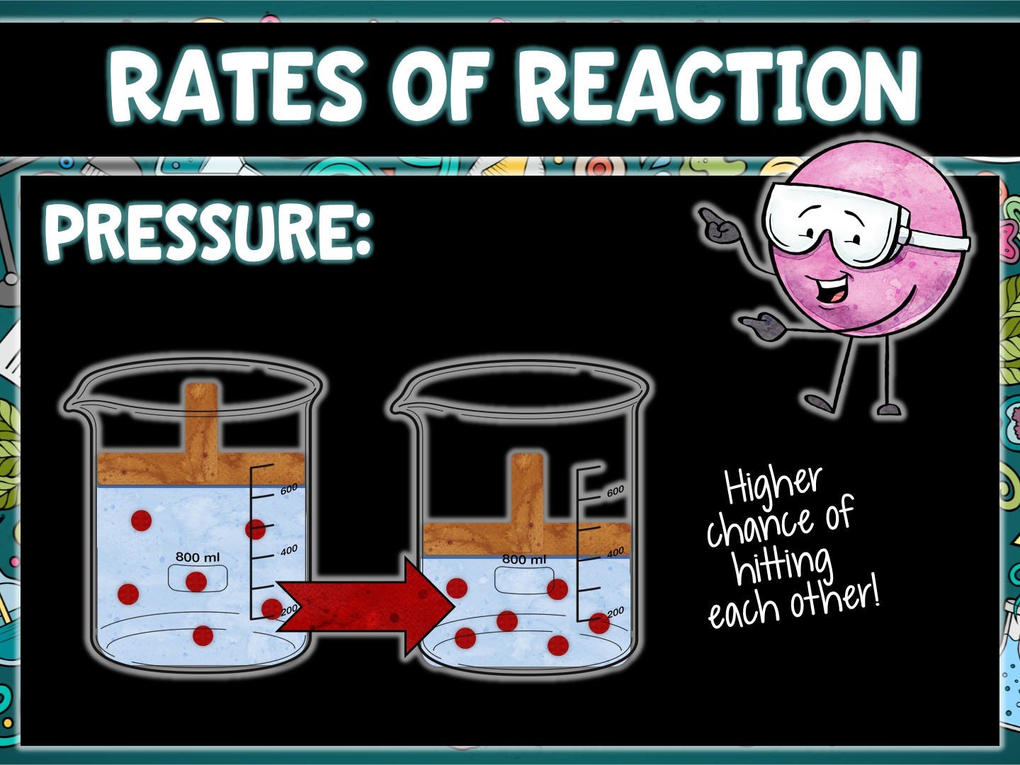

Slide 8
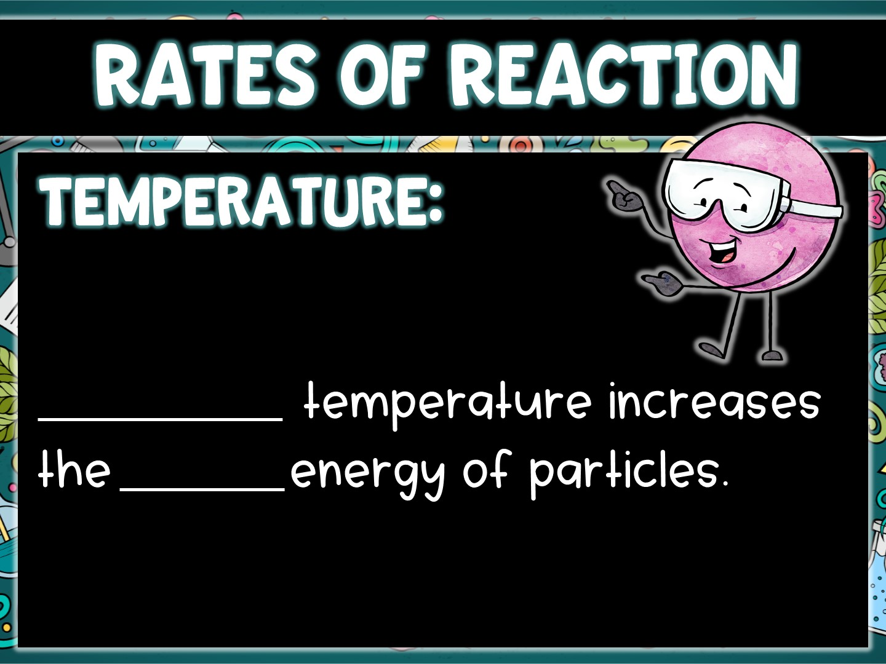
Increasing
kinetic

Slide 9
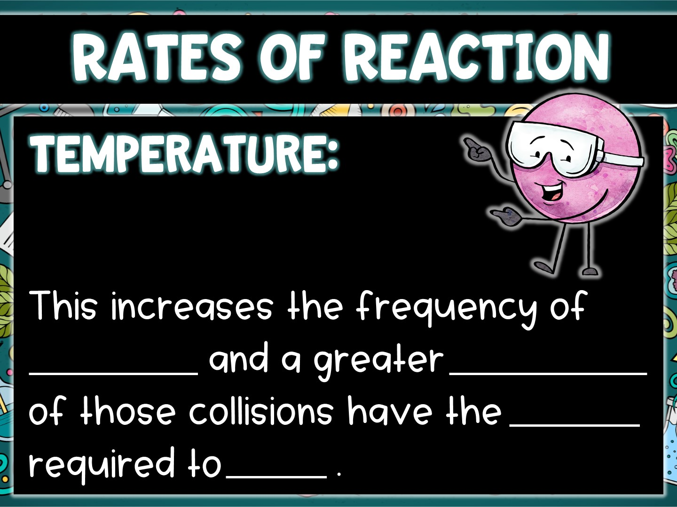
collisions
proportion
energy
react

Slide 10
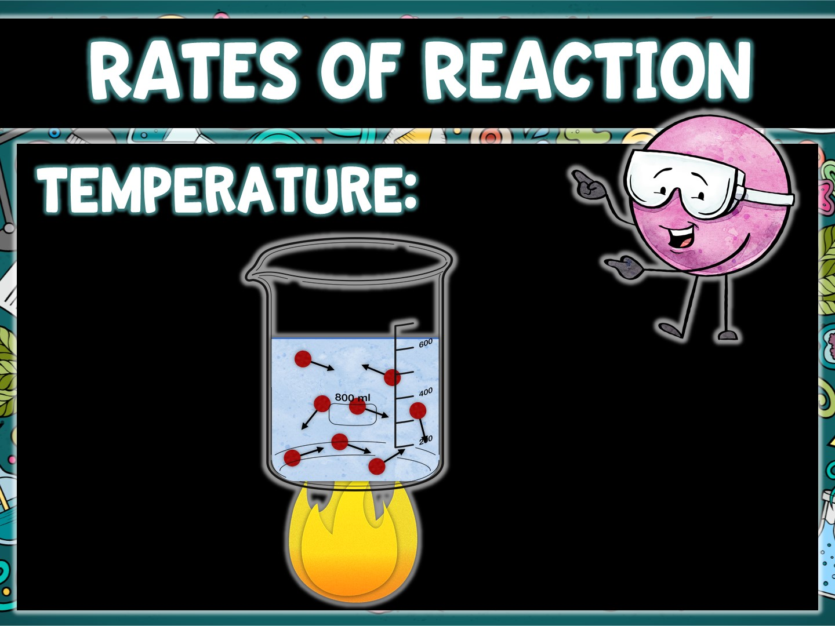

Slide 11
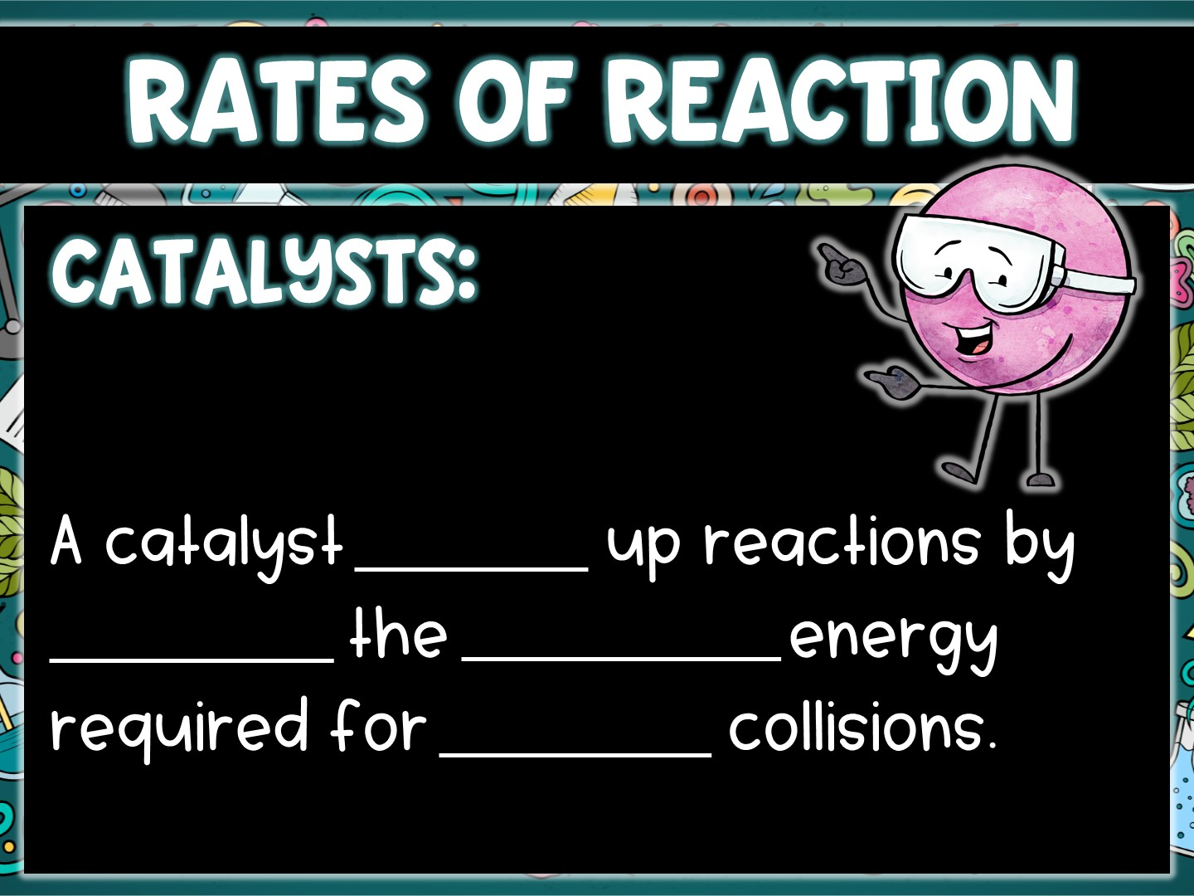
speeds
lowering
activation
reaction

Slide 12
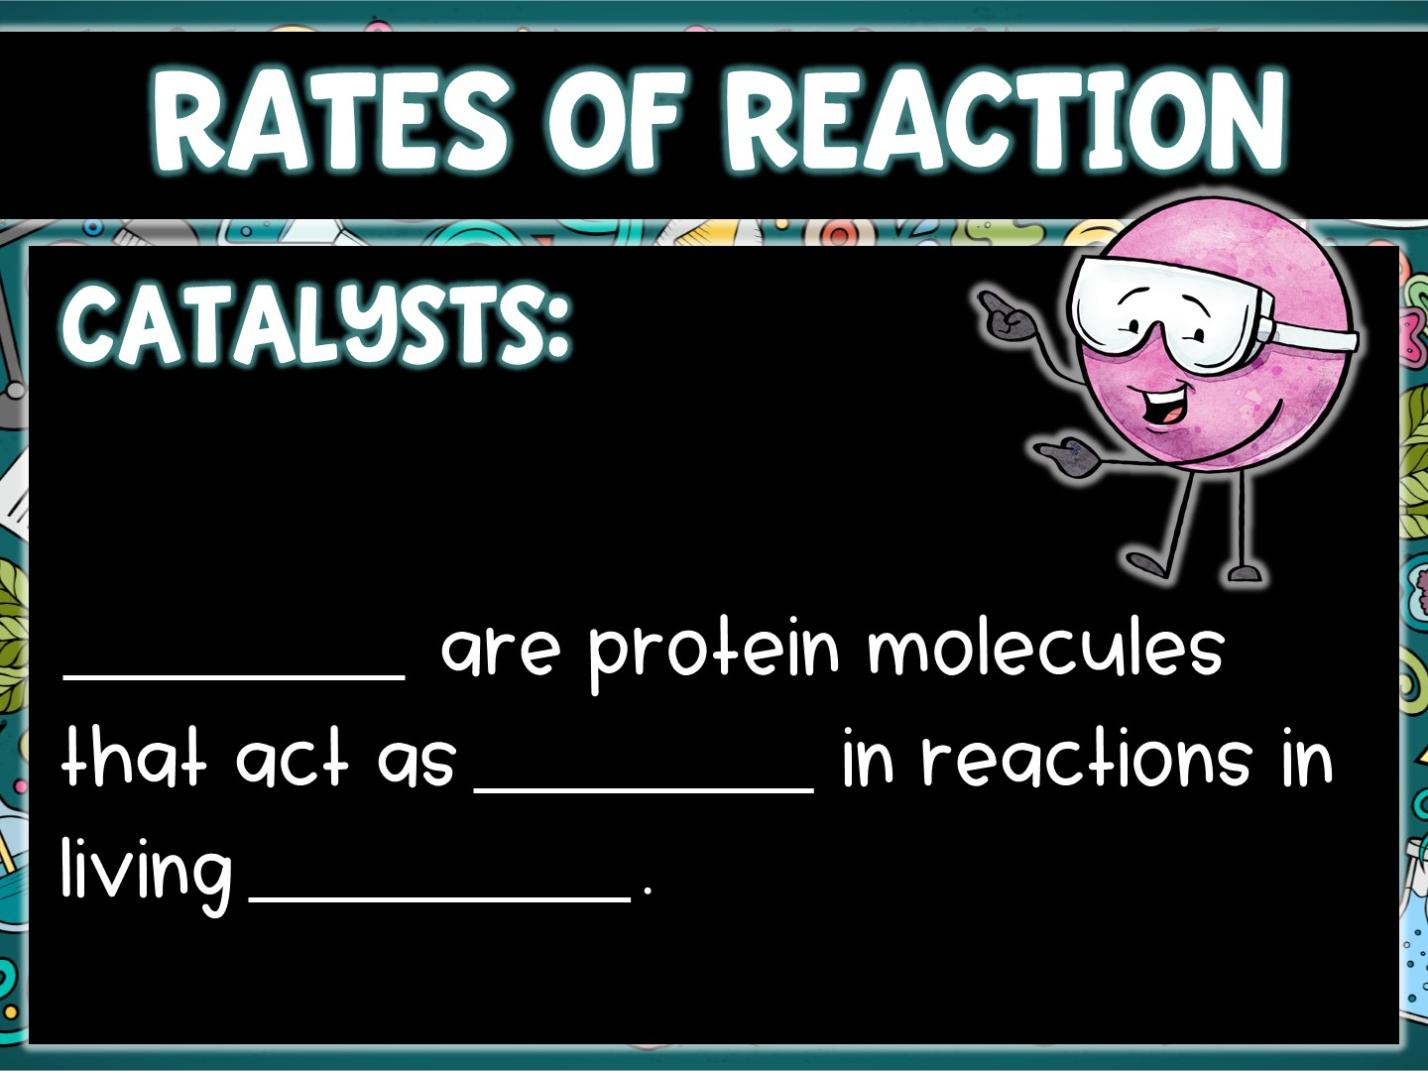
Enzymes
catalysts
organisms

Slide 13
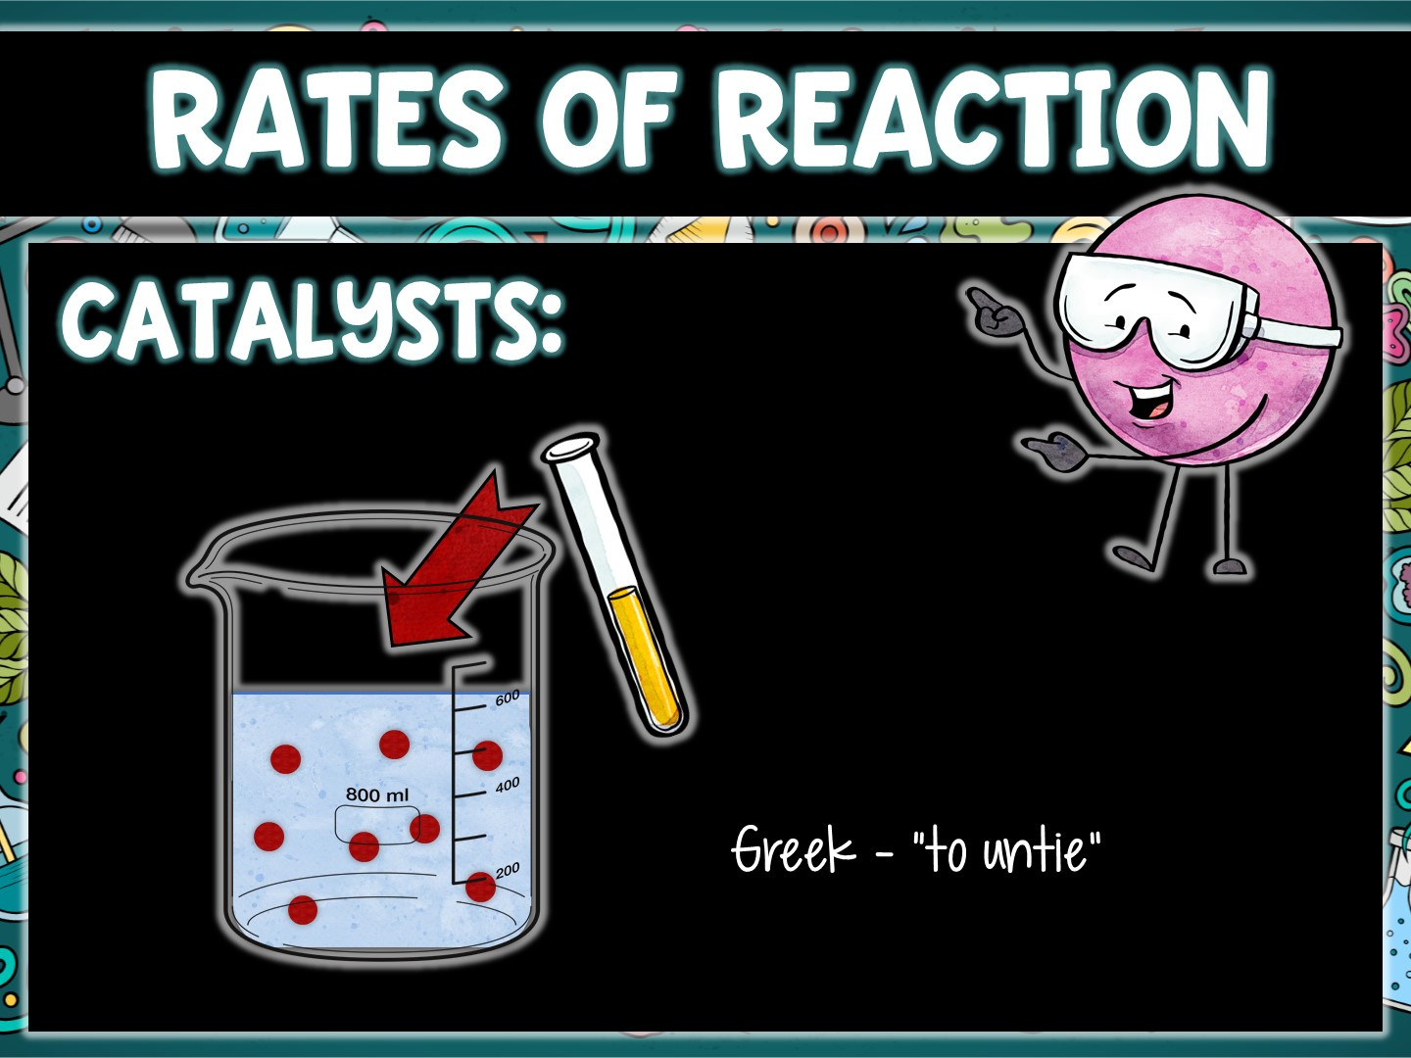

Slide 14
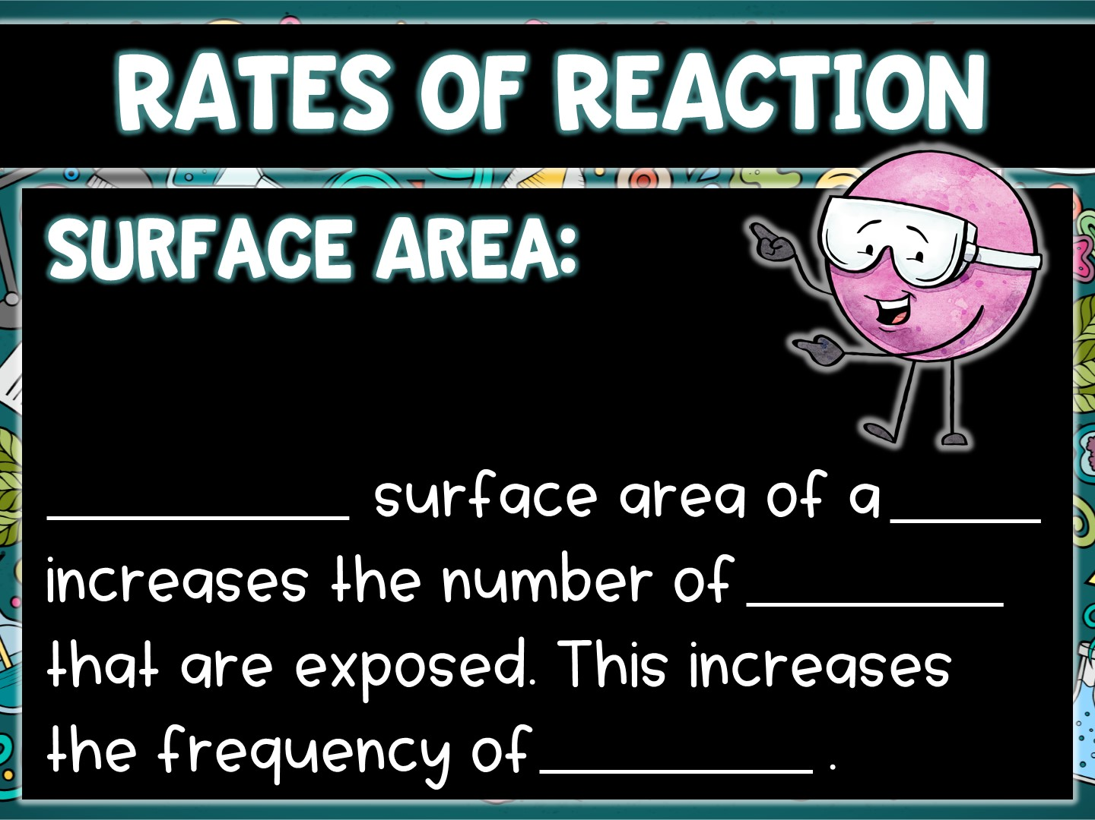
Increasing
solid
particles
collisions

Slide 15
